Slide 1
Designing an Object Detection System
Group 4

Slide 2
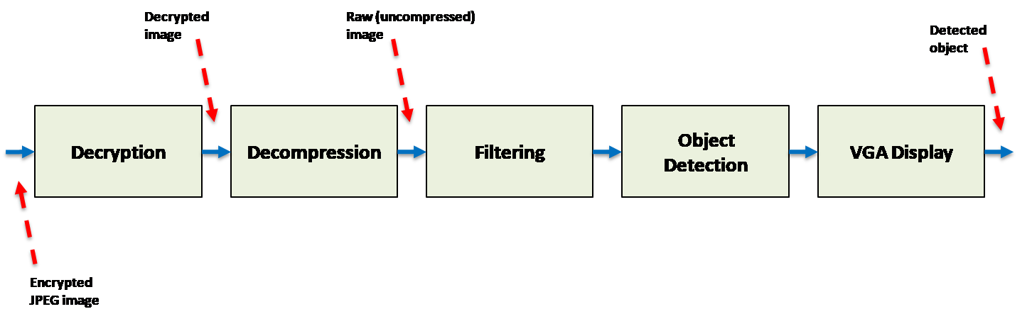
Introduction

Slide 3
ID Tags
Filter type bits | Filter
000 | Edge filter
001 | Gaussian filter
010 | Identity filter
011 | Median filter
1XX | Sobel filter
ID Tag – 8 bits
First 3 bits identify filter type
Last 5 bits is the number of the packet
ID Tag
0 | 1 | 1 | 0 | 0 | 0 | 0 | 0 | 1
Filter type
Packet number

Slide 4
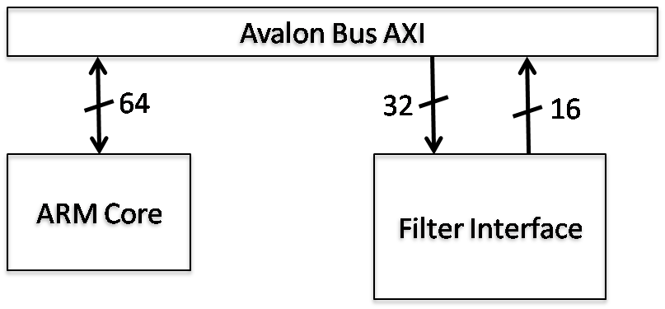
Filtering

Slide 5
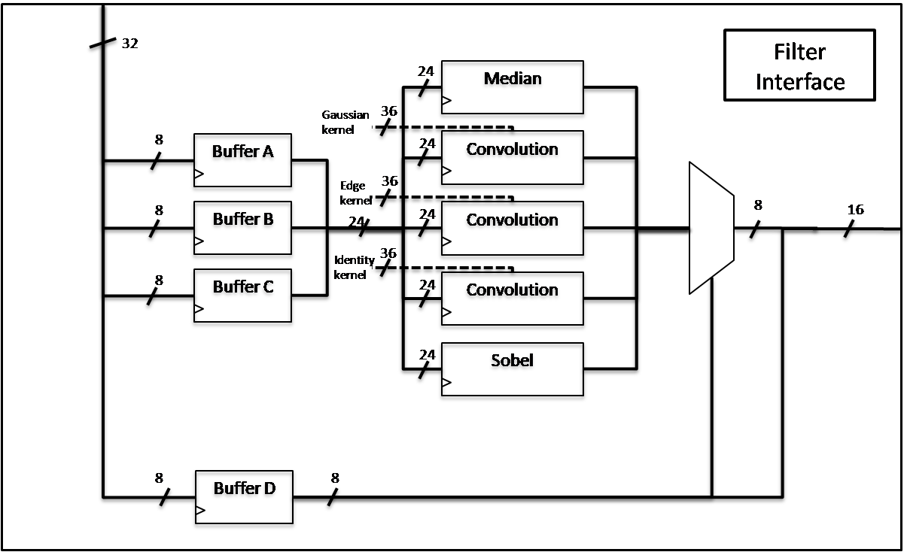
Hardware Pipelining

Slide 6
Object Detection

Slide 7
OpenCV filtering

Slide 8
VGA Cache Access
Array was being accessed using a column-major logic
Caused a lot of cache misses since C uses row-major logic
Observed a time improvement of 13.82% afterwards

Slide 9
Future Work
Daisy chaining
Dual-core
Anything else?

Slide 10
Discussion
What to discuss?

Slide 11
Performance Improvements
*I need numbers here*
Compare baseline solution with final solution

Slide 12
Final Solution
No Hitler references here plz

